Slide 1
Lecture 21
Comparing the Means and Proportions with Two Populations (Using Central Limit Theorem)

Slide 2
Data: 2009/2010 Survey of peasant workers in Beijing
Education | Number of Household Members | Insurance | Contract | Monthly Household Income | Monthly Household Consumption
教育 | 家庭 人口数 | 社会保险 | 用工 合同 | 家庭月收入 | 家庭月消费
2 | 2 | 0 | 0 | 89000 | 300
2 | 4 | 0 | 0 | 35000 | 400
1 | 5 | 0 | 0 | 3200 | 50
3 | 3 | 0 | 0 | 21000 | 350
1 | 4 | 0 | 0 | 40000 | 750
3 | 3 | 0 | 0 | 1500 | 30
4 | 4 | 0 | 0 | 34000 | 1000
3 | 6 | 0 | 1 | 4600 | 200
... | ... | ... | ... | ... | ...
an observation
Education (教育): 0=no education (未受教育), 1=primary school (小学),
  2=middle school (初中), 3=high school (高中),
4=junior college (专科), 5=college (本科)
Notes:
dfghdfghfdghgfhdfghdfgh

Slide 3



Example 1: Comparing Means with Two Populations
Cross Education-level Comparison of Mean Monthly Household Income
Education | Frequency
0 | 33 | 3234 | 2808 | 488.81
1 | 144 | 3391 | 4520 | 376.67
2 | 647 | 3615 | 5476 | 215.28
3 | 445 | 4239 | 4709 | 223.23
4 | 111 | 5152 | 7067 | 670.77
5 | 36 | 5551 | 6055 | 1009.17
Do peasant workers in Beijing with different educational levels have different average total monthly household income? E.g. Education=1 vs Education=0.

Slide 4
Example 2: Comparing Proportions with Two Populations
Cross Education-level Comparison of Proportions of Having Social Insurance
Education | Frequency
0 | 33 | 0.182 | 0.067
1 | 144 | 0.174 | 0.032
2 | 647 | 0.235 | 0.017
3 | 445 | 0.272 | 0.021
4 | 111 | 0.477 | 0.047
5 | 36 | 0.639 | 0.080
Do peasant workers in Beijing with different educational levels have different proportions of having social insurance? E.g. Education=1 vs Education=0.

Slide 5
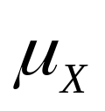
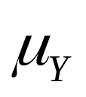
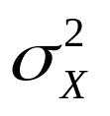

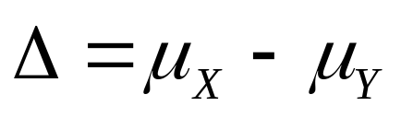
Setup
Let and represent the means for two populations, and and represent the population variances.
is the parameter that we are interested in.

Slide 6
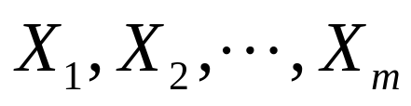
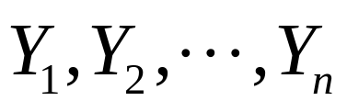
Setup
Assume there are two independent samples from these two populations.
  Sample from the first population：
  Sample from the second population：

Slide 7
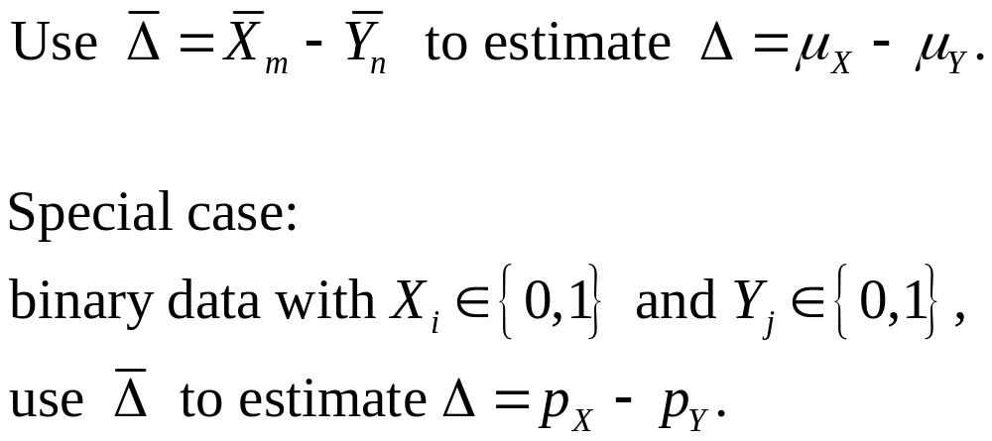
Point Estimation

Slide 8

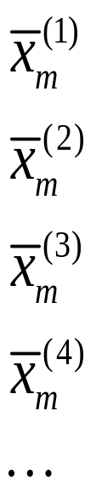
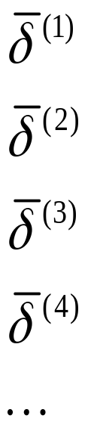
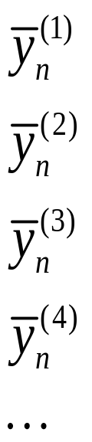
Sampling Distribution of
144
33
144
33
144
33
144
33
Education=1
Education=0

Slide 9
Some Knowledge about
Even without knowing the exact form of the sampling distribution of , statisticians can already calculate the mean, variance and standard deviation of .

Slide 10
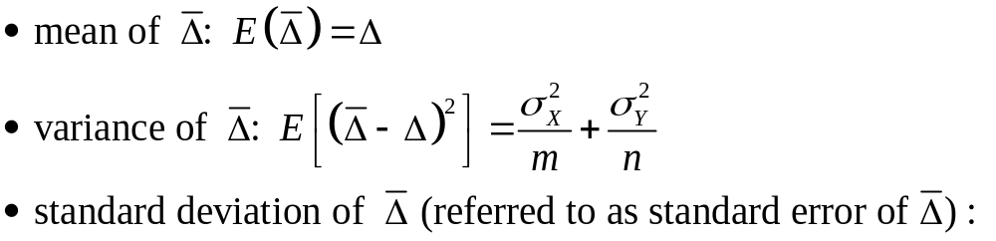
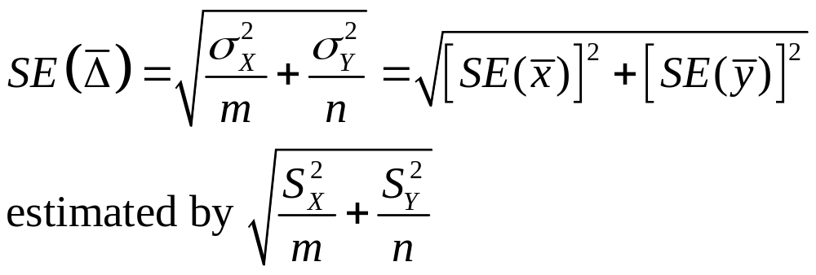
Mean, Variance and Standard Error of
Insights:
SE is related to the two sample sizes
SE is related to the two population variances

Slide 11
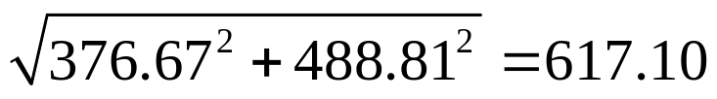
Example 1
The standard error of the difference between the sample mean of total monthly household income for those with primary school education (Education=1) and that for those with no education (Education=0) is estimated to be
Notes:
dfghdfghfdghgfhdfghdfgh

Slide 12


Example 1: Comparing Means with Two Populations
Cross Education-level Comparison of Mean Monthly Household Income
Comparison
Education=1 — Education=0 | 157 | 617.10
Education=2 — Education=1 | 224 | 433.85
Education=3 — Education=2 | 624 | 310.12
Education=4 — Education=3 | 913 | 706.94
Education=5 — Education=4 | 399 | 1211.76
Education (教育): 0=no education (未受教育), 1=primary school (小学), 2=middle school (初中),
3=high school (高中), 4=junior college (专科), 5=college (本科)

Slide 13
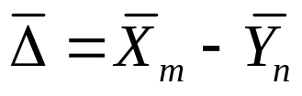
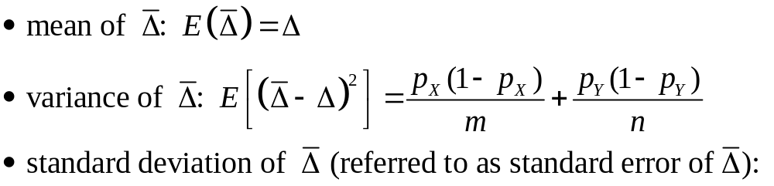
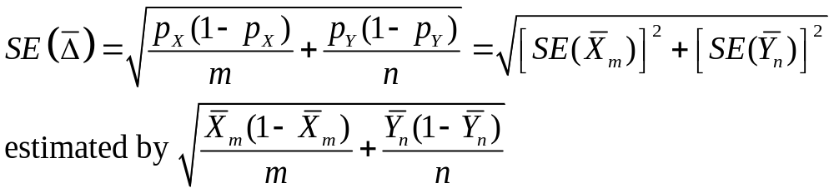
Special Case:
Mean, Variance and Standard Error of
Insights:
SE is related to the two sample sizes
SE is related to the two population proportions

Slide 14
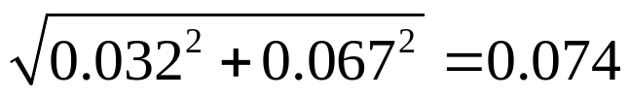
Example 2
The standard error of the difference between the sample proportion of having social insurance for those with primary school education (Education=1) and that for those with no education (Education=0) is estimated to be
Notes:
dfghdfghfdghgfhdfghdfgh

Slide 15
Example 2: Comparing Proportions with Two Populations
Cross Education-level Comparison of Proportions of Having Social Insurance
Comparison
Education=1 — Education=0 | -0.008 | 0.074
Education=2 — Education=1 | 0.061 | 0.036
Education=3 — Education=2 | 0.037 | 0.027
Education=4 — Education=3 | 0.205 | 0.052
Education=5 — Education=4 | 0.162 | 0.093
Education (教育): 0=no education (未受教育), 1=primary school (小学), 2=middle school (初中),
3=high school (高中), 4=junior college (专科), 5=college (本科)

Slide 16
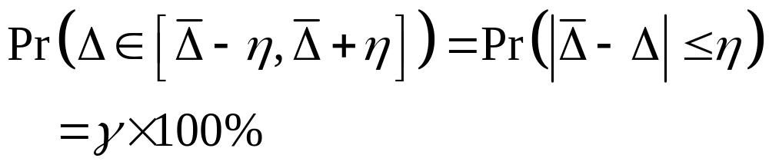
Interval Estimation
Confidence Interval

Slide 17

More Knowledge Is Needed
We need to know the form of the sampling distribution of .

Slide 18
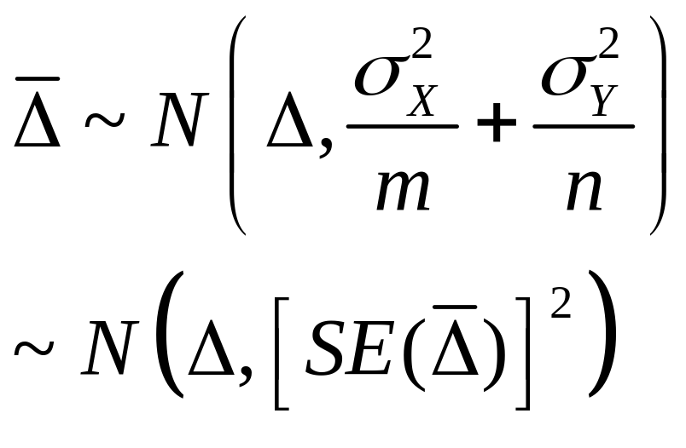
Sampling Distribution of
Using The Central Limit Theorem (Loosely):

Slide 19
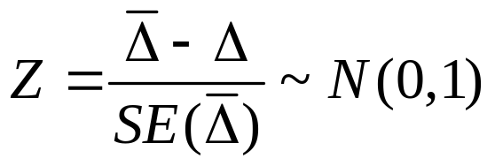
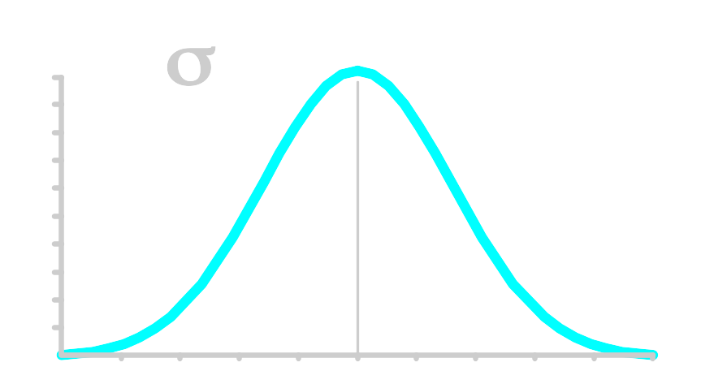
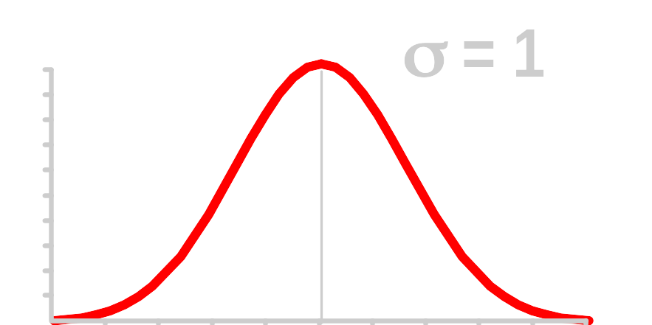






Standardizing the Sampling Distribution
Normal
Distribution
Standard Normal Distribution

Slide 20
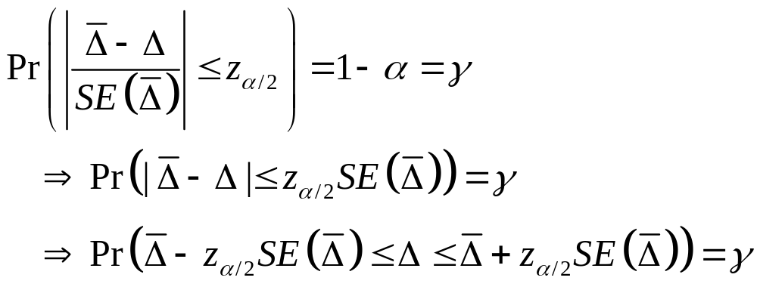
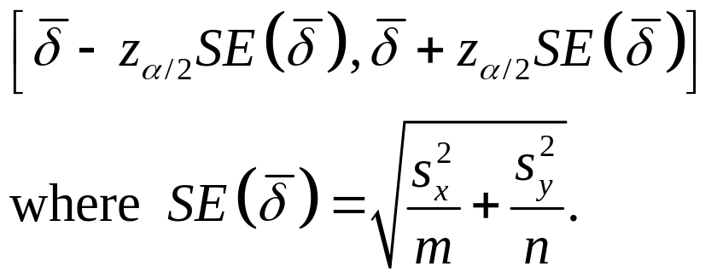
Let α=1-γ.
The confidence interval for μ is

Slide 21


Example 1: Comparing Means with Two Populations
Cross Education-level Comparison of Mean Monthly Household Income
Comparison |  | 95% confidence interval for
Education=1 — Education=0 | 157 | [-1052.52, 1366.52]
Education=2 — Education=1 | 224 | [-626.35, 1074.35]
Education=3 — Education=2 | 624 | [16.16, 1231.84]
Education=4 — Education=3 | 913 | [-472.60, 2298.60]
Education=5 — Education=4 | 399 | [-1976.05, 2774.05]
Education (教育): 0=no education (未受教育), 1=primary school (小学), 2=middle school (初中),
3=high school (高中), 4=junior college (专科), 5=college (本科)

Slide 22
Example 2: Comparing Proportions with Two Populations
Cross Education-level Comparison of Proportions of Having Social Insurance
Comparison |  | 95% confidence interval for
Education=1 — Education=0 | -0.008 | [-0.153, 0.137]
Education=2 — Education=1 | 0.061 | [-0.010, 0.132]
Education=3 — Education=2 | 0.037 | [-0.016, 0.090]
Education=4 — Education=3 | 0.205 | [0.103, 0.307]
Education=5 — Education=4 | 0.162 | [-0.021, 0.344]
Education (教育): 0=no education (未受教育), 1=primary school (小学), 2=middle school (初中),
3=high school (高中), 4=junior college (专科), 5=college (本科)

Slide 23

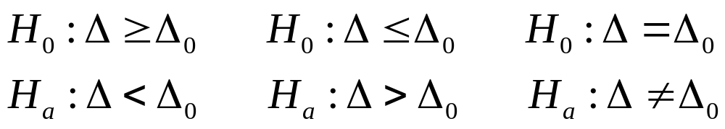
Three Forms of Hypothesis Tests about
one-sided test
two-sided test

Slide 24
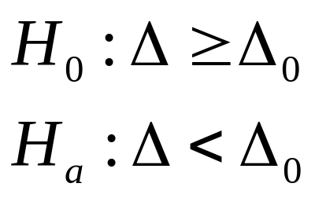
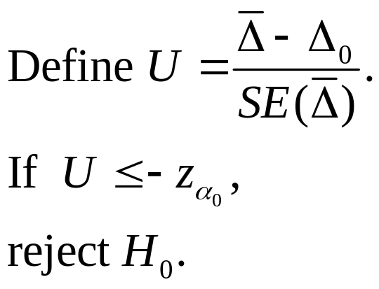
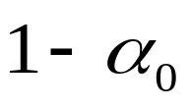

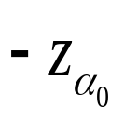


One-sided Test (1): Critical Value Approach

Slide 25
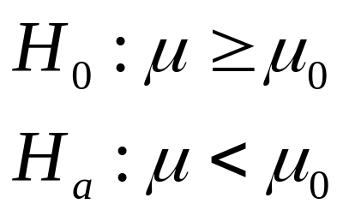
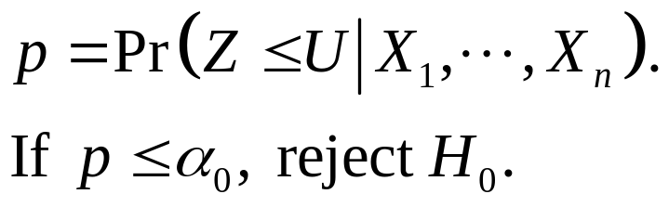
One-sided Test (1): p Value Approach
p
u

Slide 26
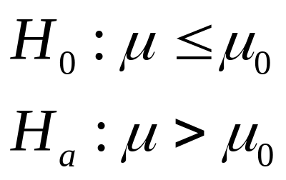
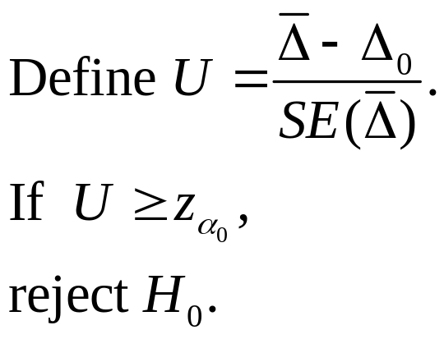

One-sided Test (2): Critical Value Approach

Slide 27

One-sided Test (2): p Value Approach
p
u

Slide 28
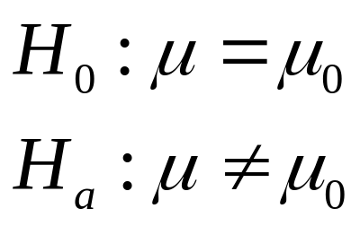
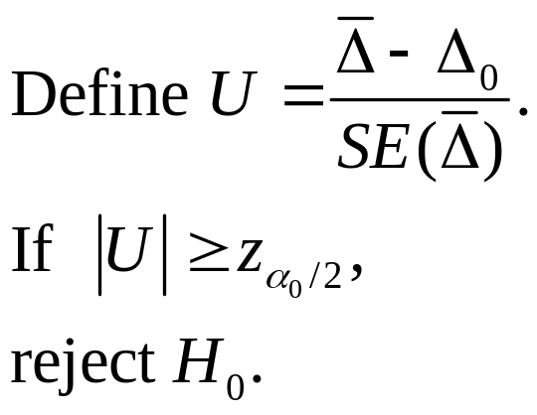
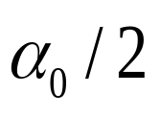
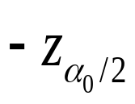
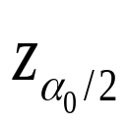
Two-sided Test: Critical Value Approach

Slide 29
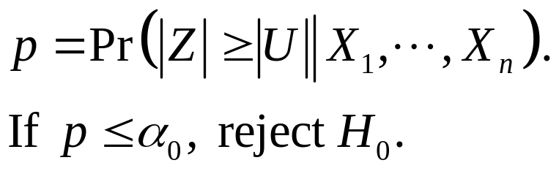

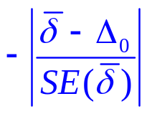
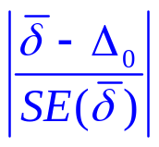
Two-sided Test: p Value Approach
p/2
p/2

Slide 30
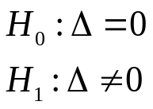
Example 1: Comparing Means with Two Populations
Cross Education-level Comparison of Mean Monthly Household Income
Comparison |  |  | 95% confidence interval for | p value for testing
Education=1 — Education=0 | 157 | 617.10 | [-1052.52, 1366.52] | 0.8026
Education=2 — Education=1 | 224 | 433.85 | [-626.35, 1074.35] | 0.6030
Education=3 — Education=2 | 624 | 310.12 | [16.16, 1231.84] | 0.0444
Education=4 — Education=3 | 913 | 706.94 | [-472.60, 2298.60] | 0.1970
Education=5 — Education=4 | 399 | 1211.76 | [-1976.05, 2774.05] | 0.7414
Education (教育): 0=no education (未受教育), 1=primary school (小学), 2=middle school (初中),
3=high school (高中), 4=junior college (专科), 5=college (本科)

Slide 31
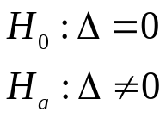
Example 2: Comparing Proportions with Two Populations
Cross Education-level Comparison of Proportions of Having Social Insurance
Comparison |  |  | 95% confidence interval for | p value for testing
Education=1 — Education=0 | -0.008 | 0.074 | [-0.153, 0.137] | 0.9124
Education=2 — Education=1 | 0.061 | 0.036 | [-0.010, 0.132] | 0.091
Education=3 — Education=2 | 0.037 | 0.027 | [-0.016, 0.090] | 0.1706
Education=4 — Education=3 | 0.205 | 0.052 | [0.103, 0.307] | <0.002
Education=5 — Education=4 | 0.162 | 0.093 | [-0.021, 0.344] | 0.0818
Education (教育): 0=no education (未受教育), 1=primary school (小学), 2=middle school (初中),
3=high school (高中), 4=junior college (专科), 5=college (本科)

